Slide 1


EMC Underground: MetroLabs
MetroLabs

Slide 2
Environment

Slide 3
Environment
Internet
Virtualization Platform
(VirtualBox)
GitHub.com
Client VM
Master VM
Source Code Management
Ubuntu 16.04
Open Puppet Agent
Docker
Web Server
Content
Ubuntu 16.04
Open Puppet
Jenkins Server

Slide 4
Tools
Laptop
Virtualization Platform (VirtualBox)
Github.com (Source Code Control)
Puppet (Configuration Management)
Jenkins (Continuous Integration & Delivery)

Slide 5
VM Network Environment
External Network (NAT)
Internet
Master
Client
Internal Network (Host-only Adapter)

Slide 6
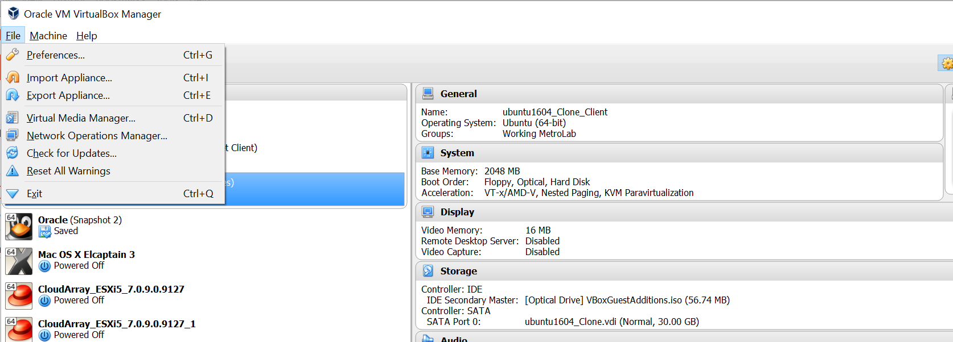
Create Host Only Network
Select Preferences

Slide 7
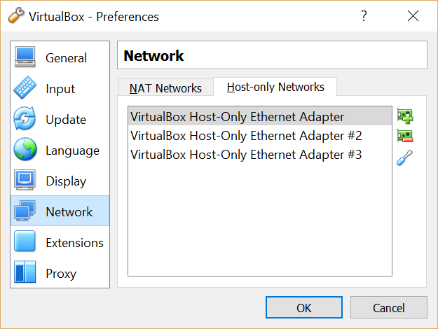
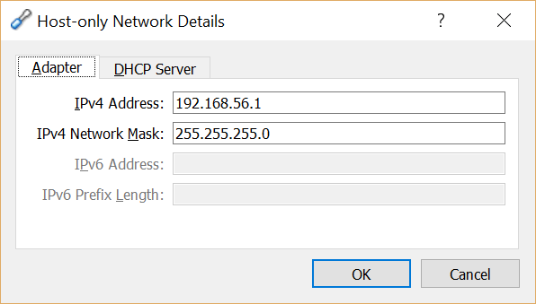
Add Host-Only Network
Write down IP Address
This will be used for adding static IP addresses to the Ubuntu VMs
Verify that there is a Host-Only Adapter configured
Select Network
Click Screwdriver to view network settings.

Slide 8
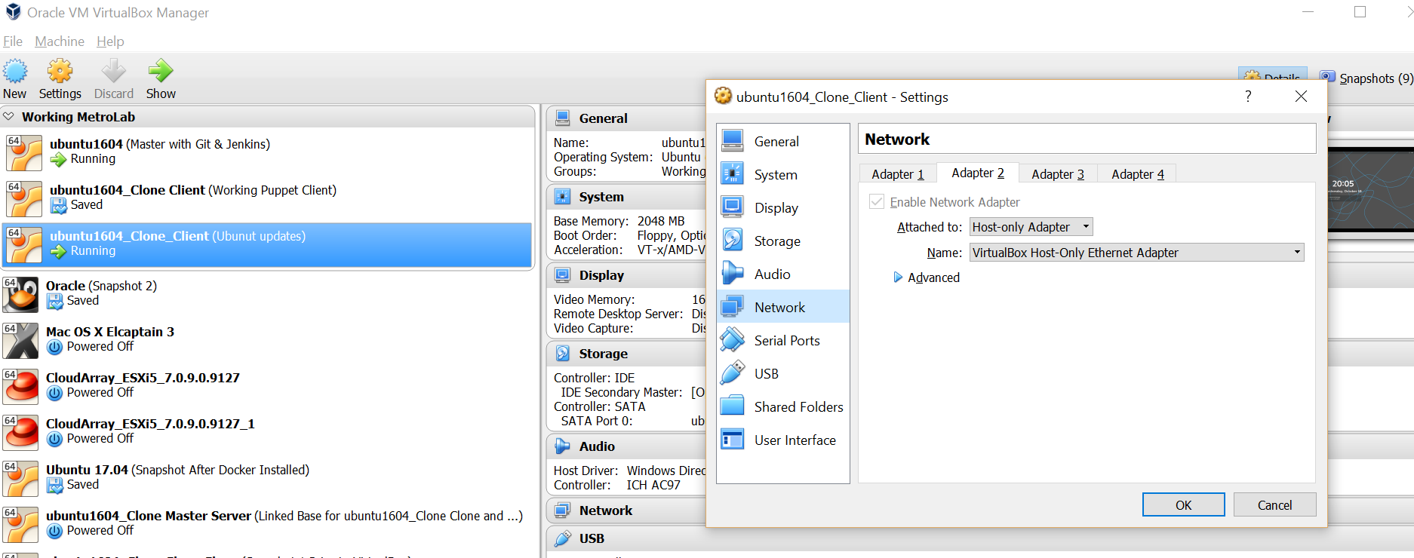
Attach Host Only Network to VM
Select VM
Select Network

Slide 9
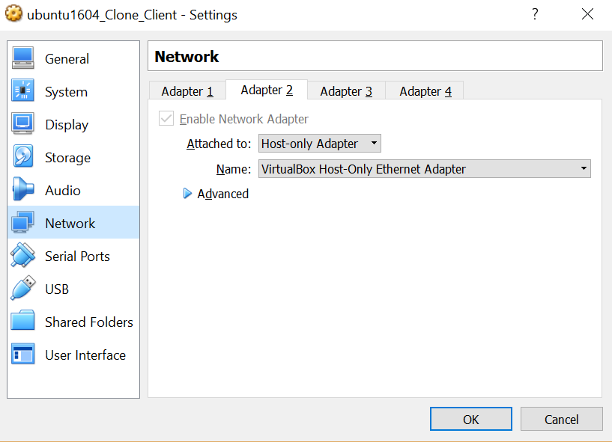
Attach Host Only Network to VM
Select Adapter 2
Host-only Adapter
VirtualBox Host-Only Ethernet Adapter

Slide 10
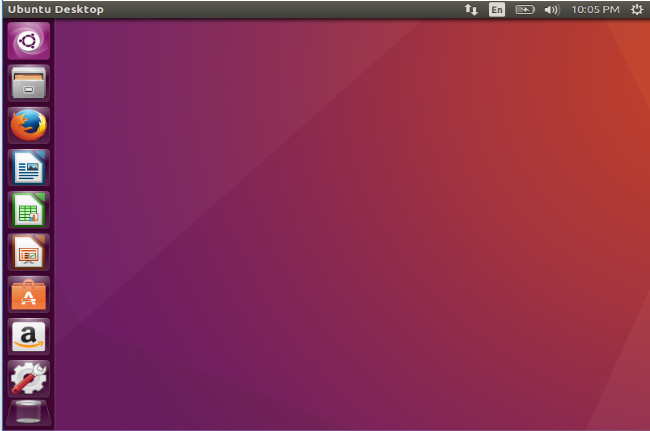
Assign Static IP Address
Select the network button
Then Select ‘Connection Information’

Slide 11
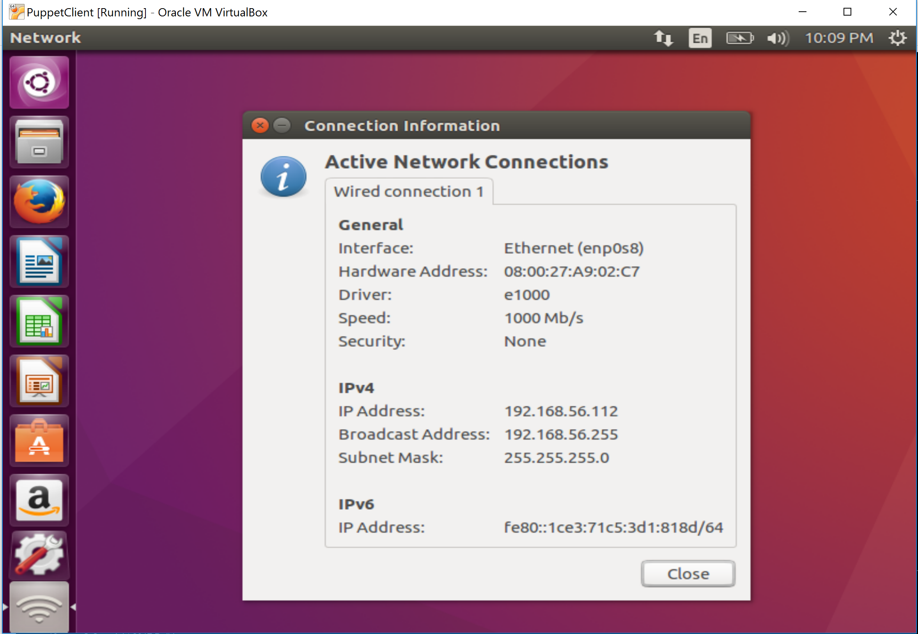
Assign Static IP Address
Select the network button
Then Select ‘Connection Information’
Note the Interface and Hardware Address

Slide 12
Assign Static IP Address
Close Connection Information
Select the network button
Then Select ‘Edit Connections’

Slide 13
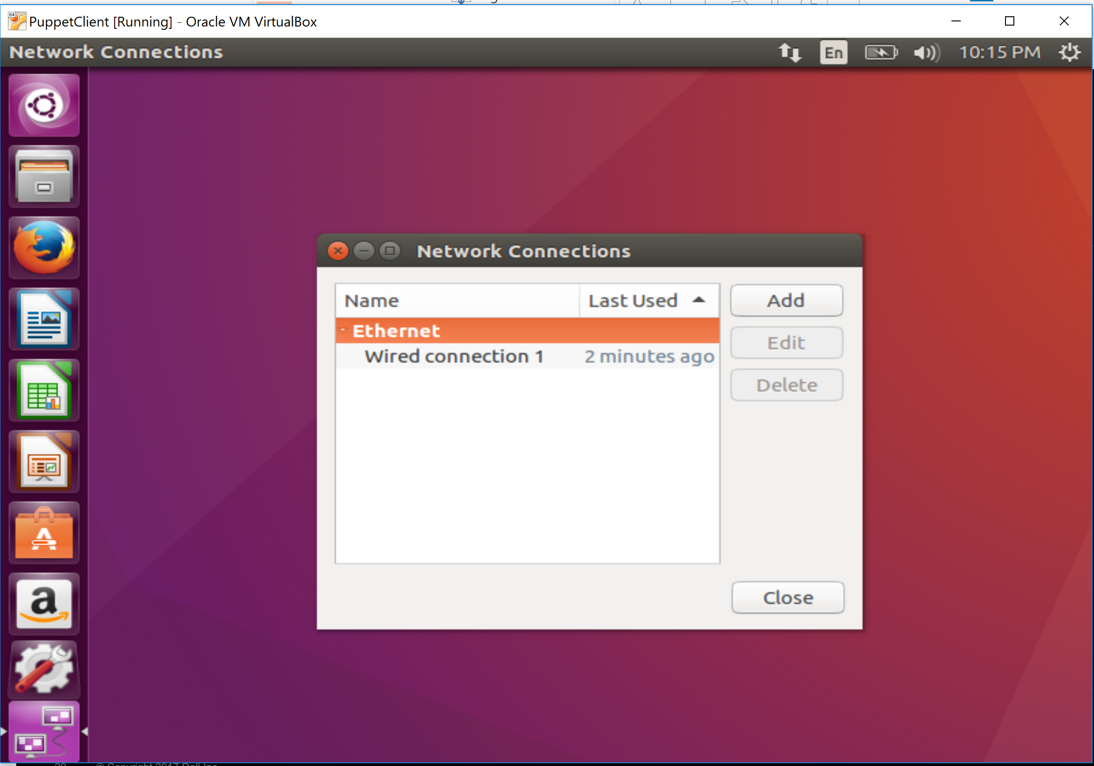
Assign Static IP Address
Select ‘Add’

Slide 14
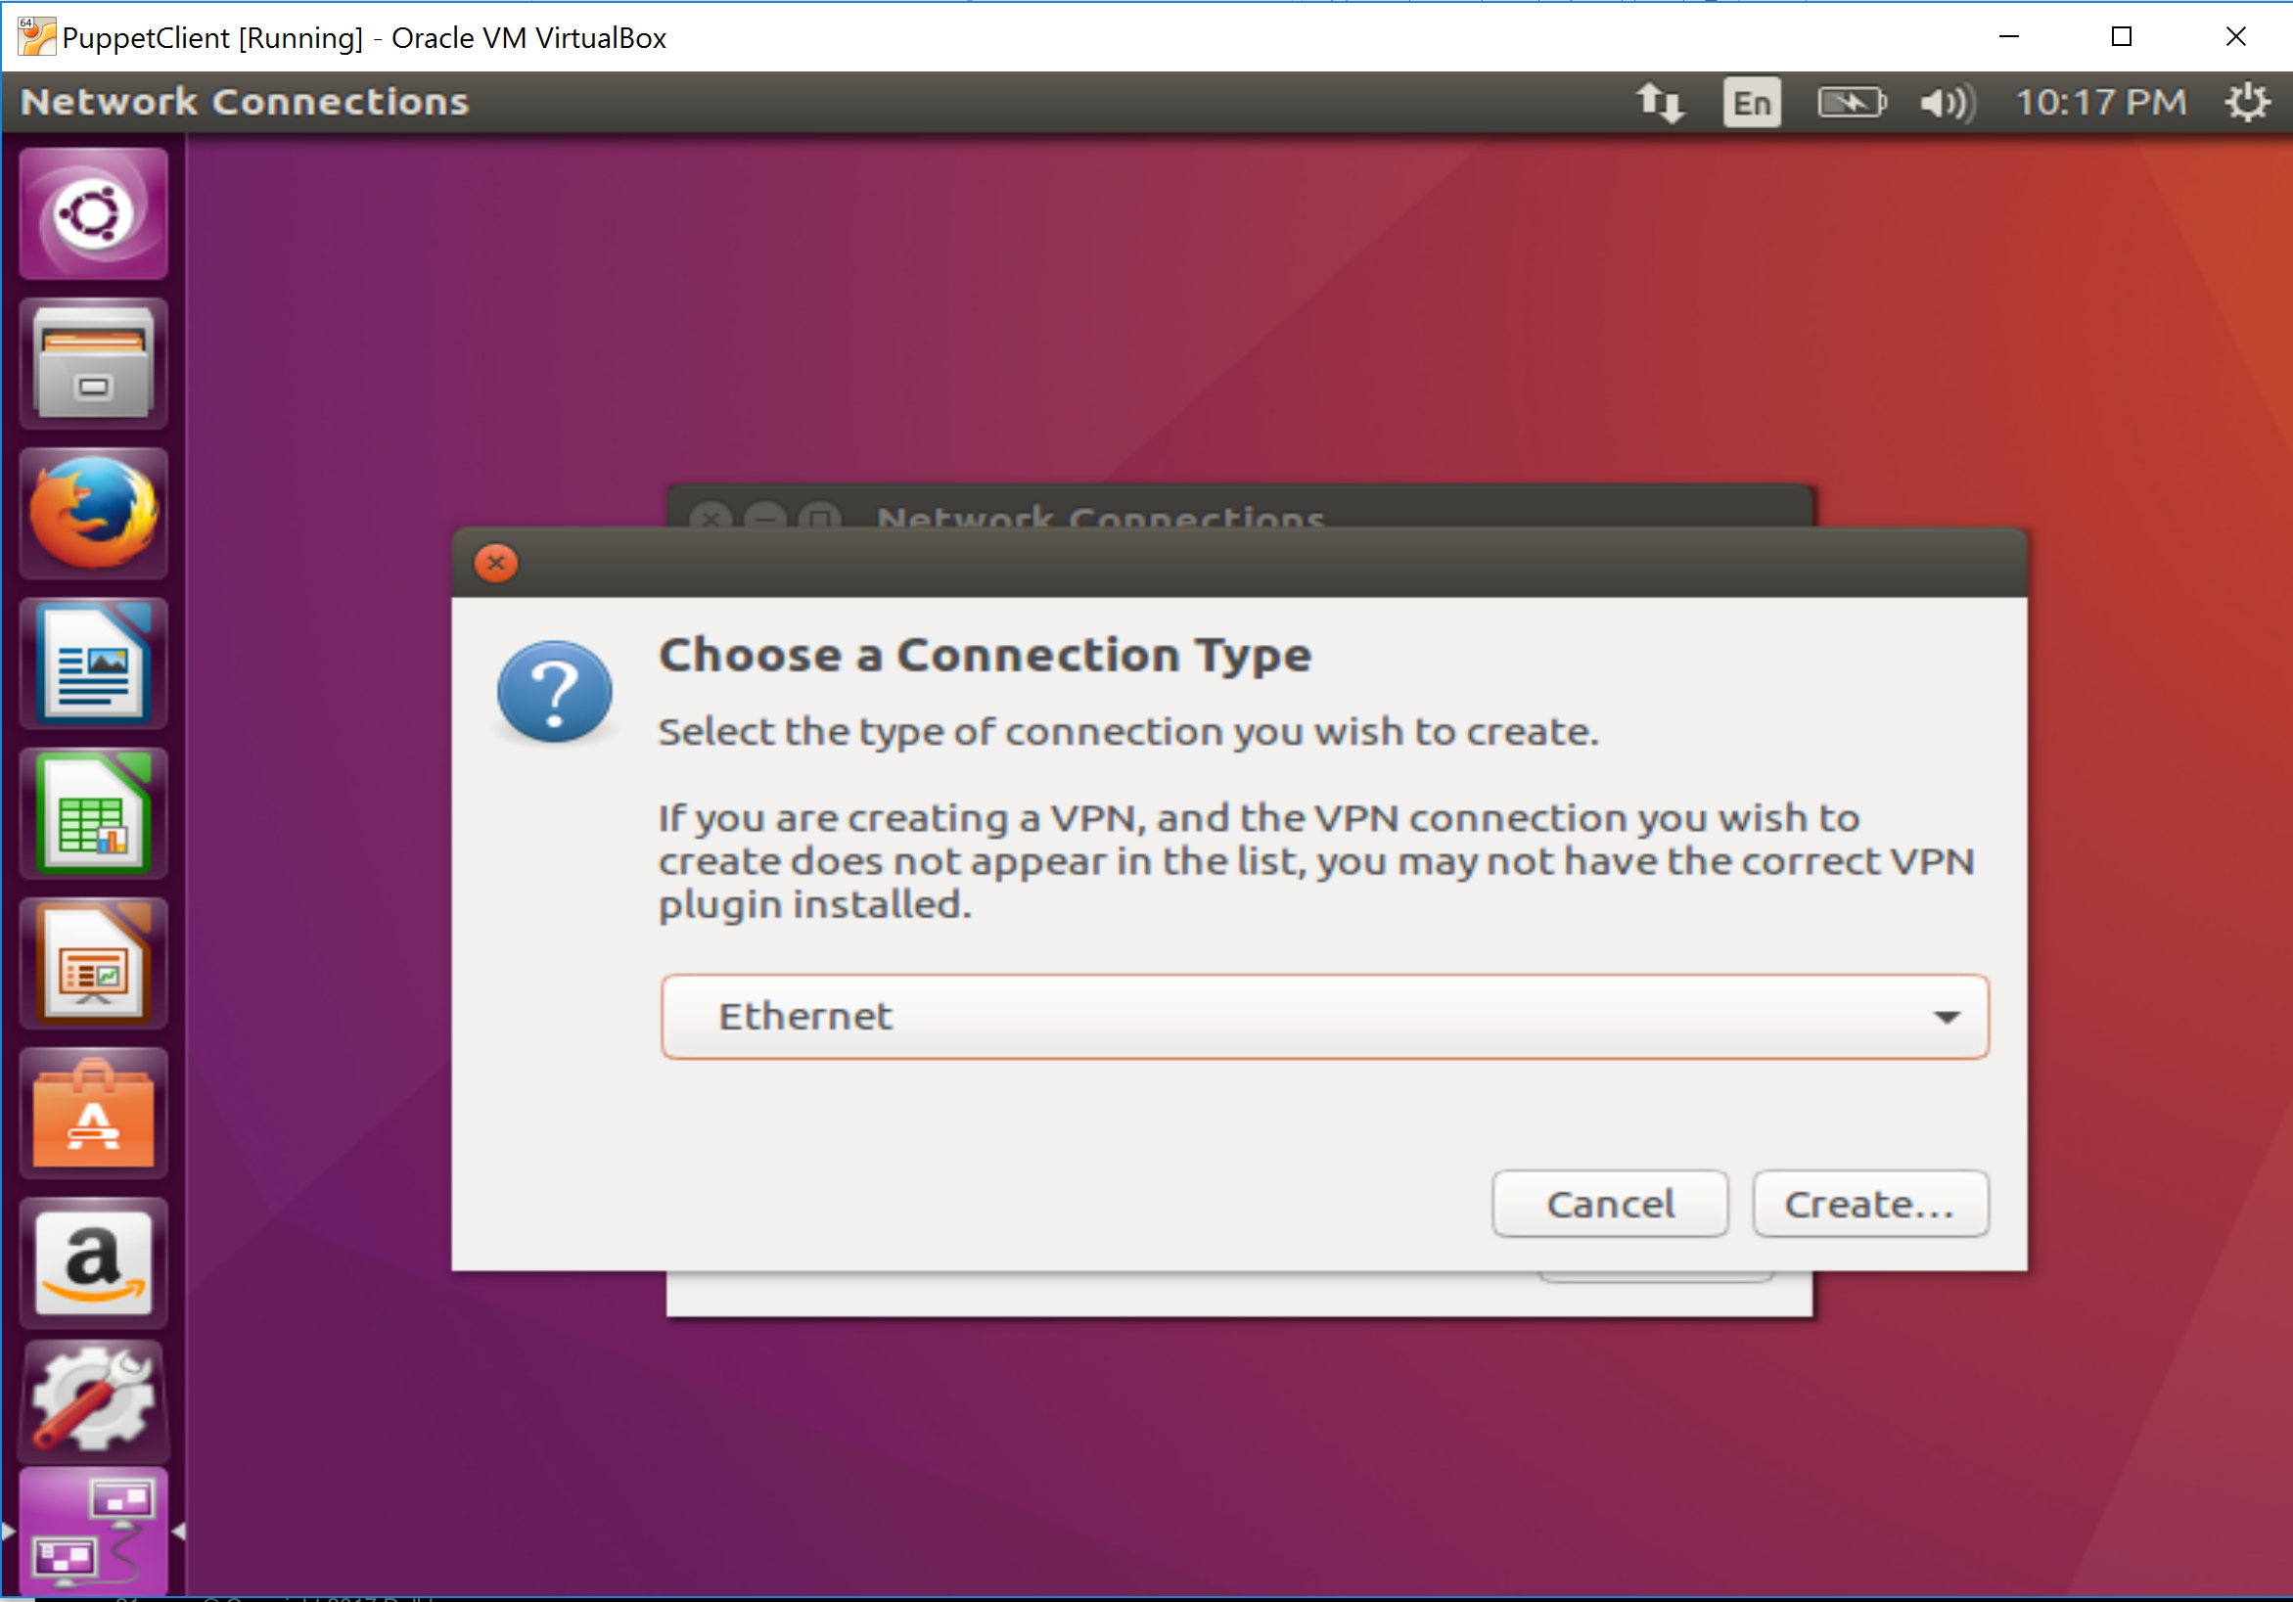
Assign Static IP Address
Leave as Ethernet
Select ‘Create’

Slide 15
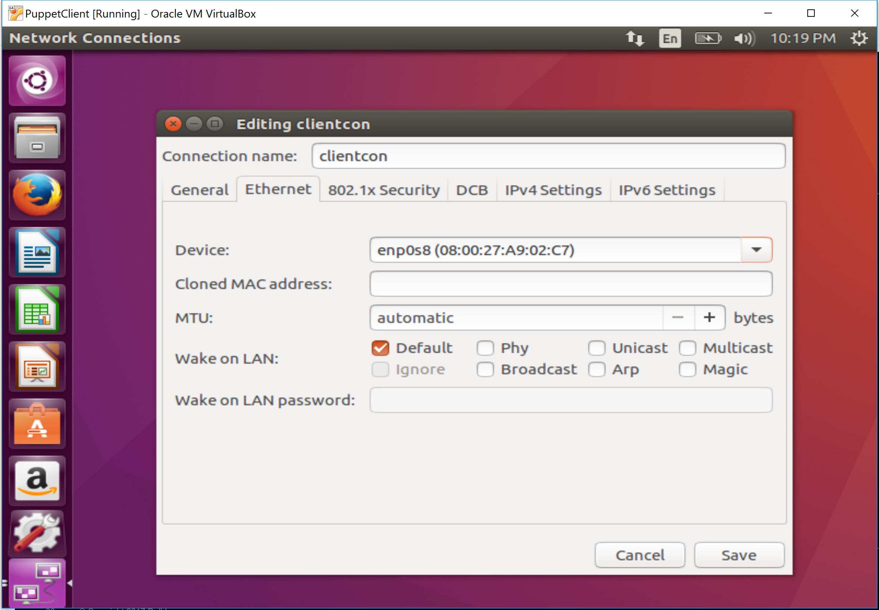
Assign Static IP Address
Name connection (i.e. mastercon)
Set device to the prior noted interface

Slide 16
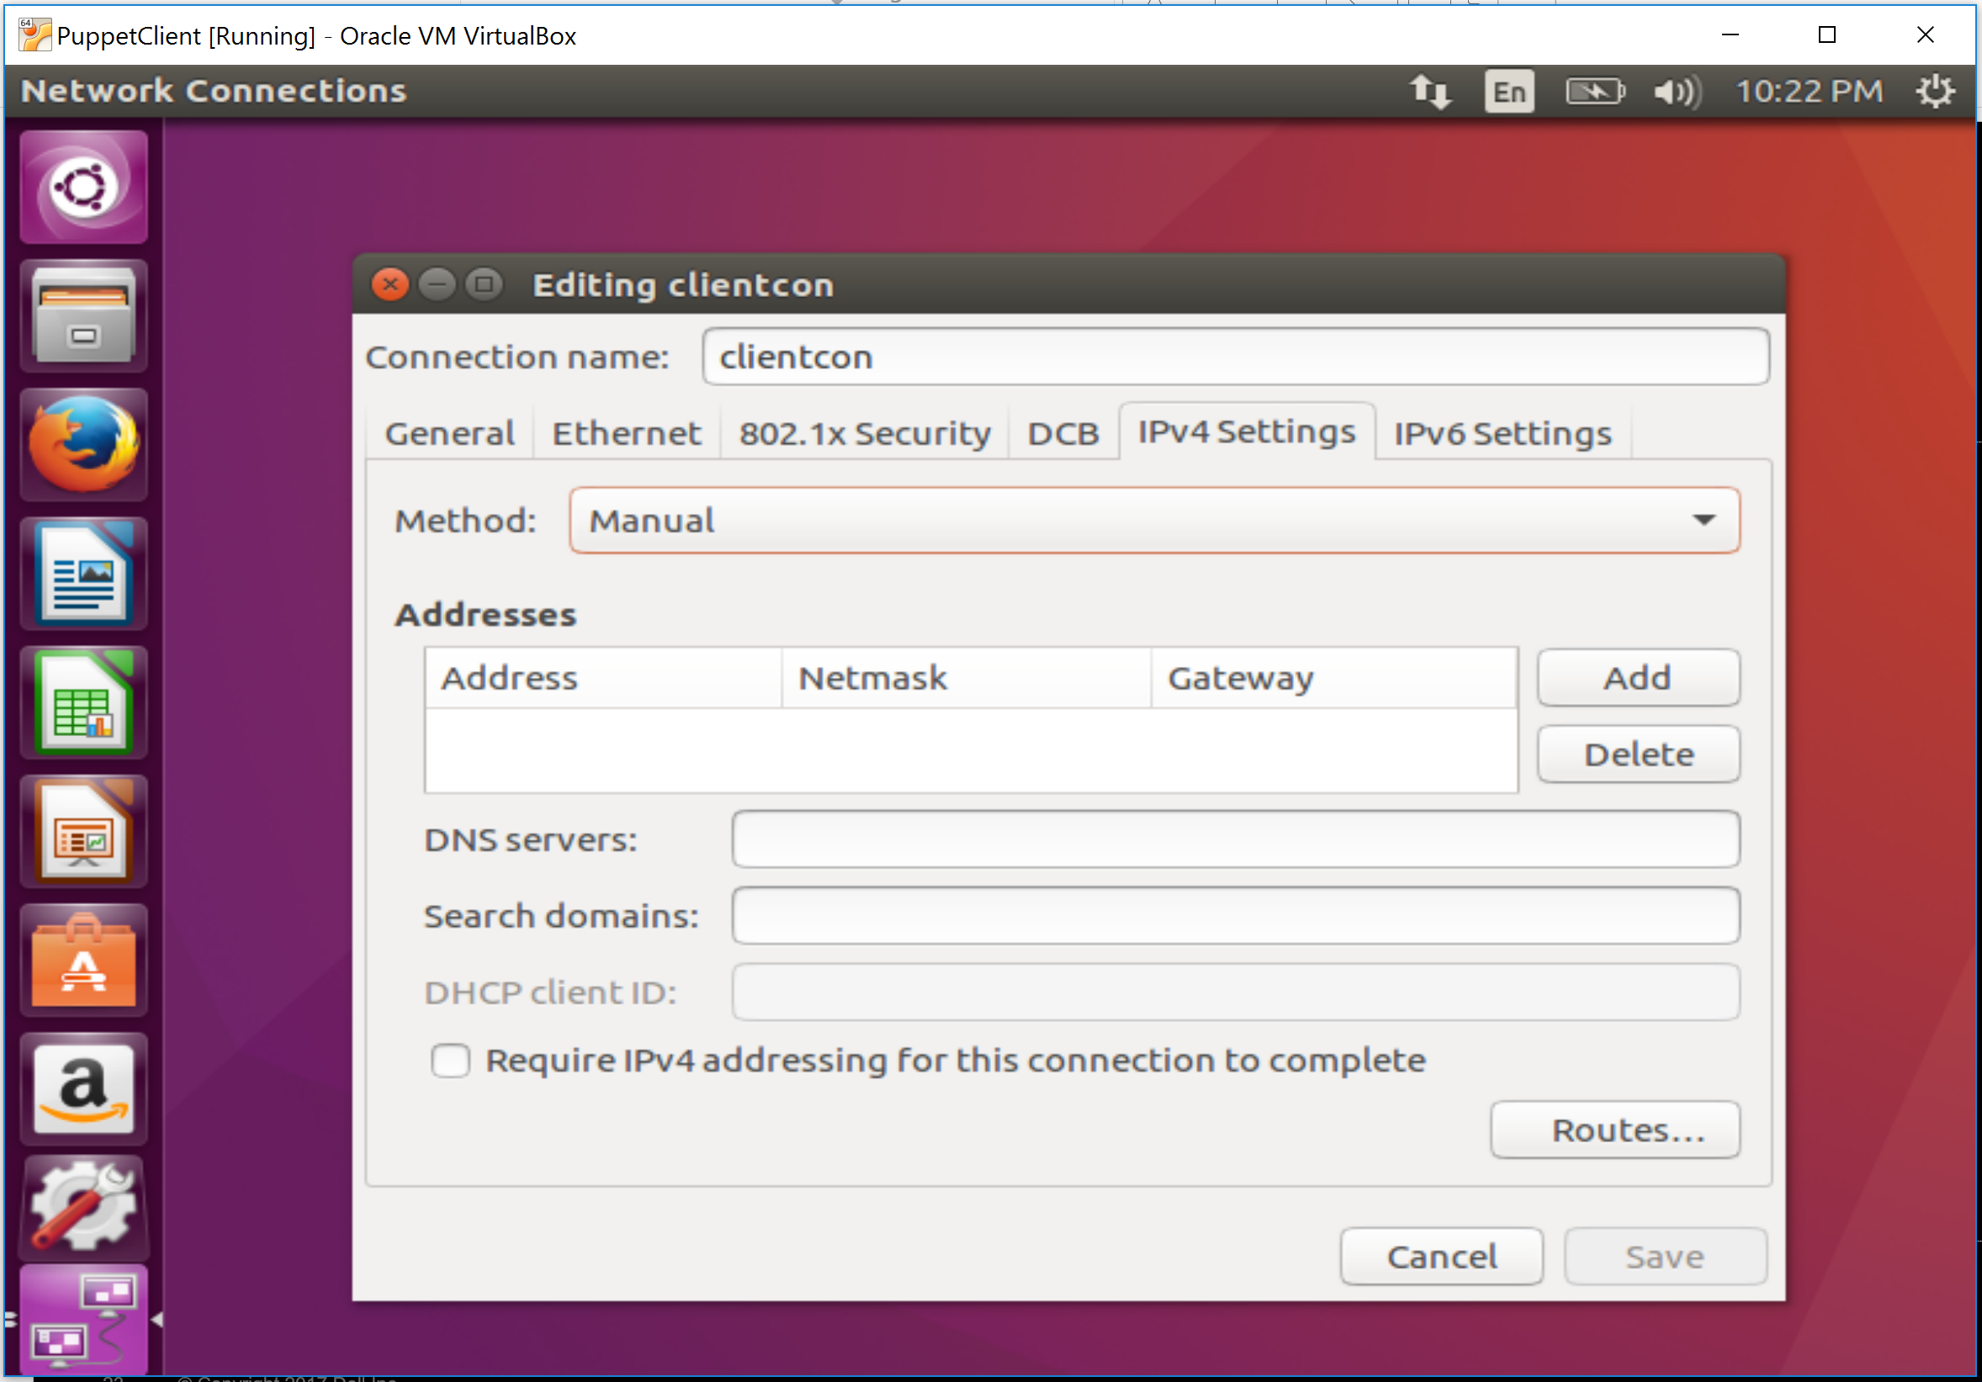
Assign Static IP Address
Select IPv4 Settings
Change Method to Manual

Slide 17
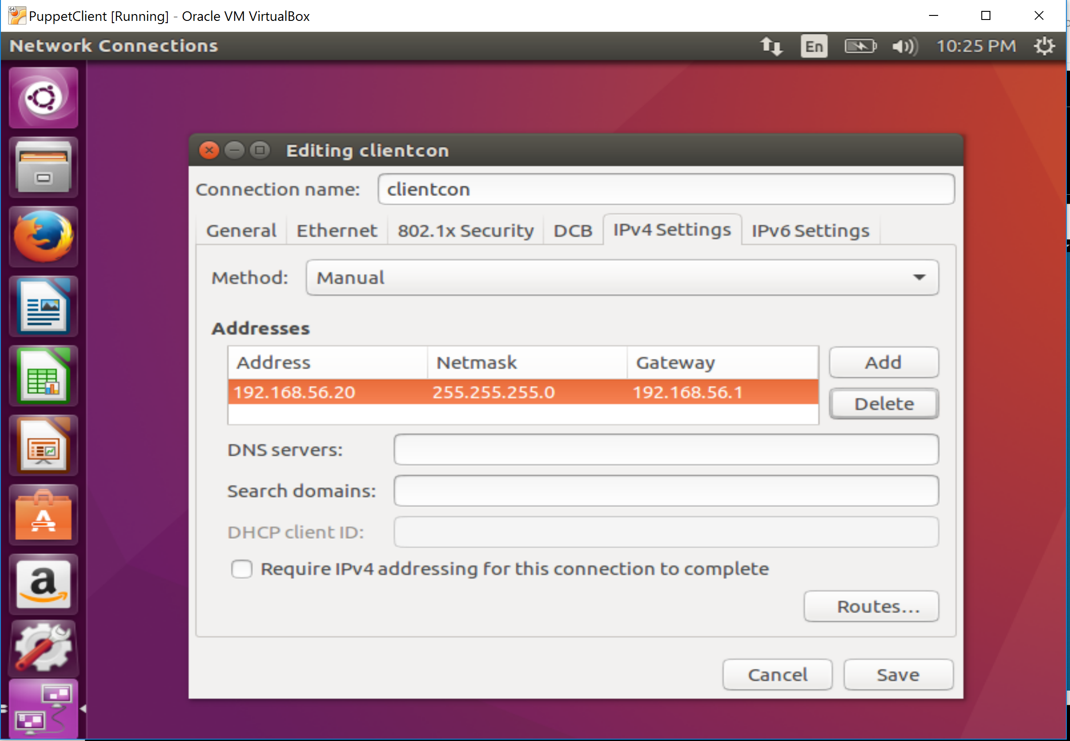
Assign Static IP Address
Add an address and make it a static IP. Make the master x.x.x.10 and the client x.x.x.20.

Slide 18
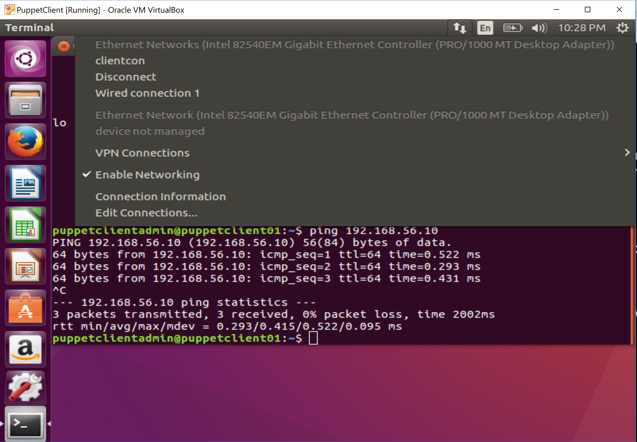
Assign Static IP Address
Save the profile, then set it active by selecting it in the network menu

Slide 19
Repeat this process for the 2nd VM

Slide 20
Creating a Github Account

Slide 21
Create a GitHub Account
https://github.com/join

Slide 22
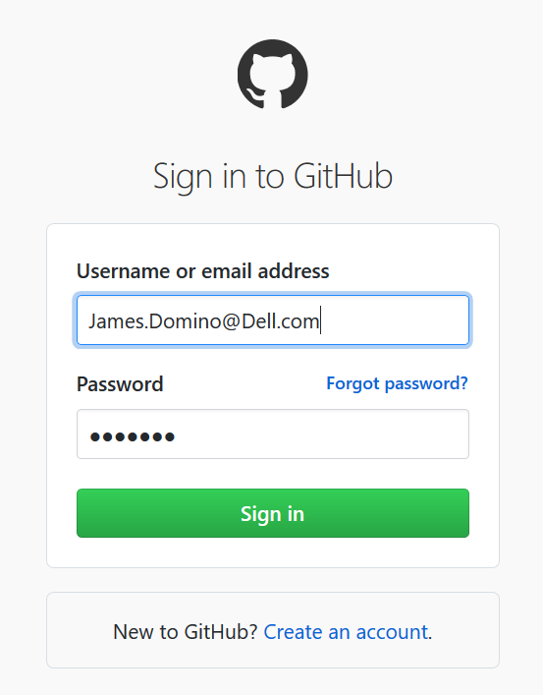
Login Into Github
https://github.com/login

Slide 23
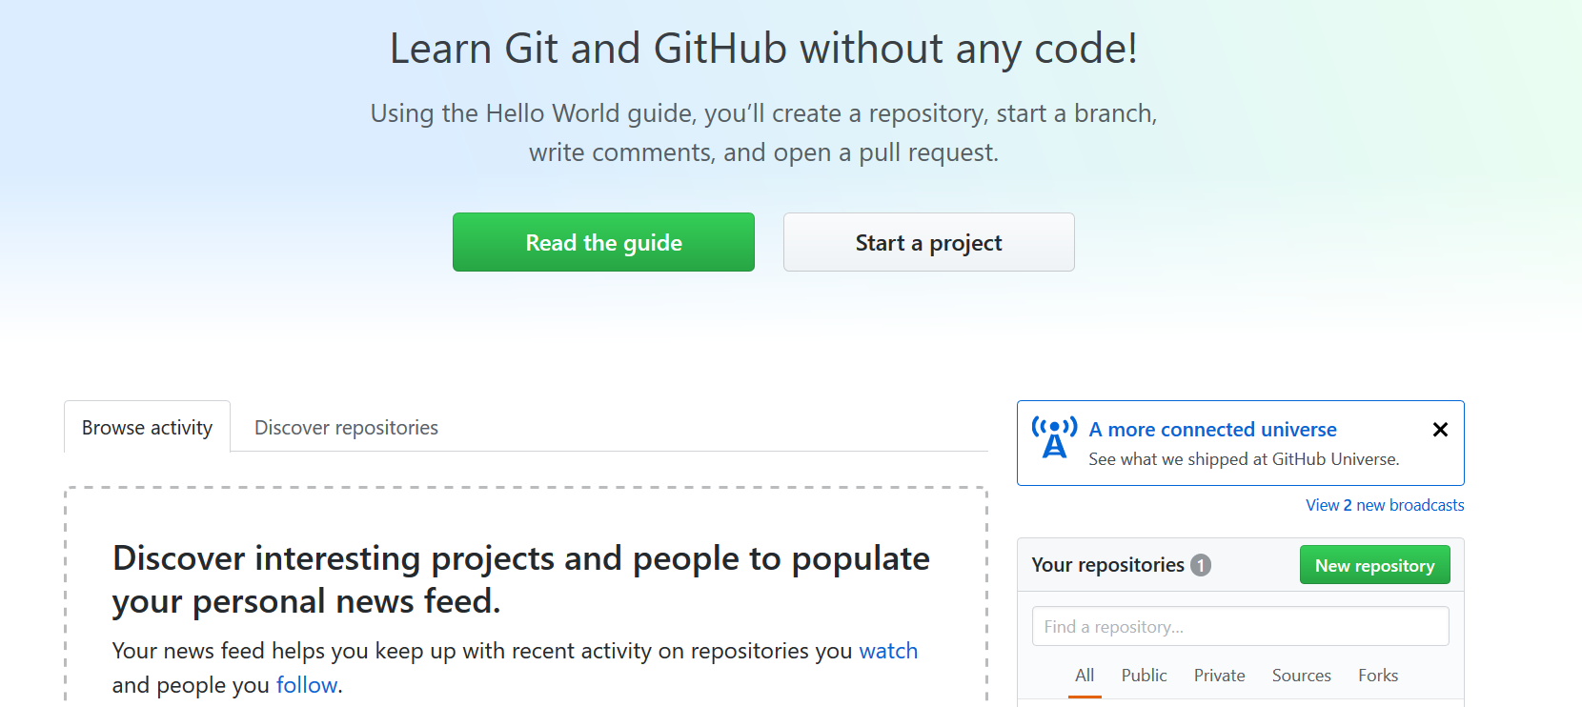
Create a New Repository
Create a Github repository.

Slide 24
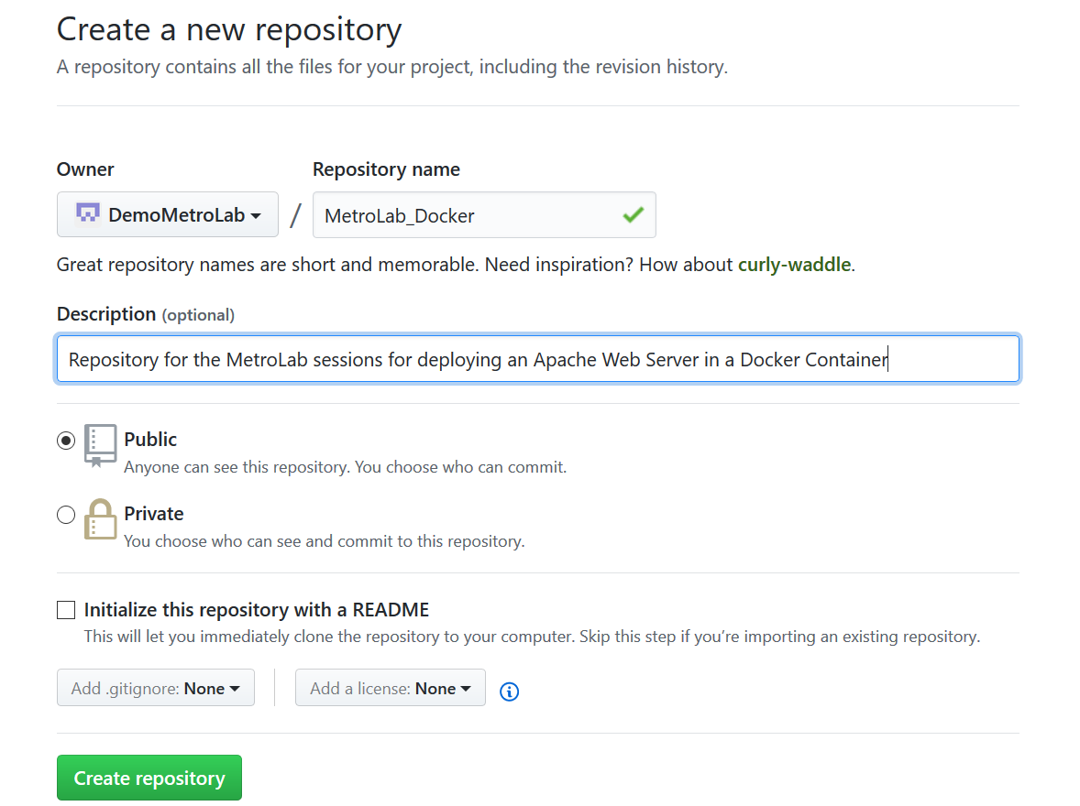
Creating a New Repository
Pick a name for your repository.
Add a description.

Slide 25
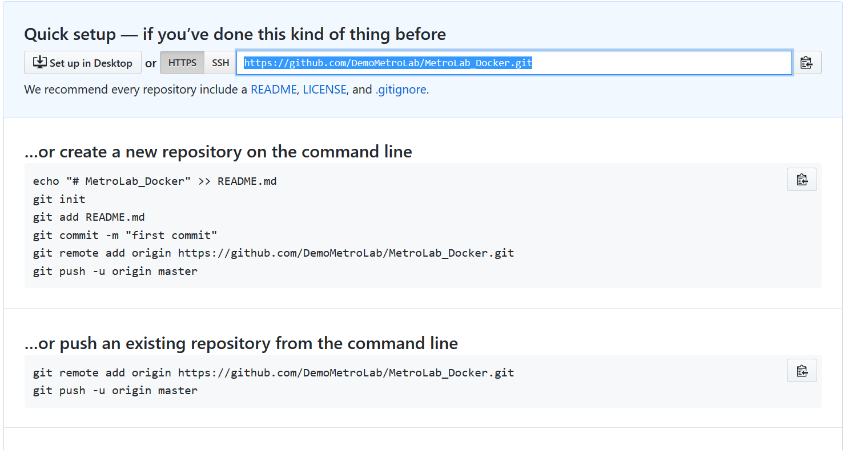
Remote Repository Created
Make note of the repository URL, will need this later to upload files and pull files.

Slide 26
Testing Git and Github
Start the VM
Login into VM
Open a Terminal Window
$ cd /opt
$ sudo mkdir MetroLab_Docker
$ cd MetroLab_Docker
$ sudo git init
This will Initialize the git repository
$ sudo bash
Currently logged in as puppet, this switches to Root user, and $ switches to #

Slide 27
Testing Git and Github
Execute the following in a Terminal Window in the VM
# echo "echo \"Hello World\"" > helloworld.sh
Creates a file called helloworld.sh that contains the text echo “Hello World”
# git status
You will see the following as your file is picked up by git.
On branch master
Initial commit
Untracked files:
(use "git add <file>..." to include in what will be committed)
helloworld.sh
nothing added to commit but untracked files present (use "git add" to track)

Slide 28
Testing Git and Github
# git add helloworld.sh
# git status
On branch master
Initial commit
Changes to be committed:
(use "git rm --cached <file>..." to unstage)
new file: helloworld.sh
# git commit -m "Testing pushing to MetroLab_Docker Repository in Github"
# Commits the tracked changes and prepares them to be pushed to a remote repository. To remove this commit and modify the file, use 'git reset --soft HEAD~1' and commit and add the file again.
Notes:
git config --global user.email "puppetmaster@emc.com" git config --global user.name "Puppet Master"

Slide 29
Prepare Local Git Repository to Push to Remote
# git remote -v
Shows that there is nothing in the repository
# git remote add origin <Remote_Repository_URL>
Enter in your site
Sets the new remote - https://github.com/DemoMetroLab/MetroLab_Docker.git
# git remote -v
Verifies the new remote repository
URLoriginhttps://github.com/DemoMetroLab/MetroLab_Docker.git (fetch)
origin https://github.com/DemoMetroLab/MetroLab_Docker.git (push)
# git ls-tree -r master --name-only
Verify file in remote repository
helloworld.sh

Slide 30
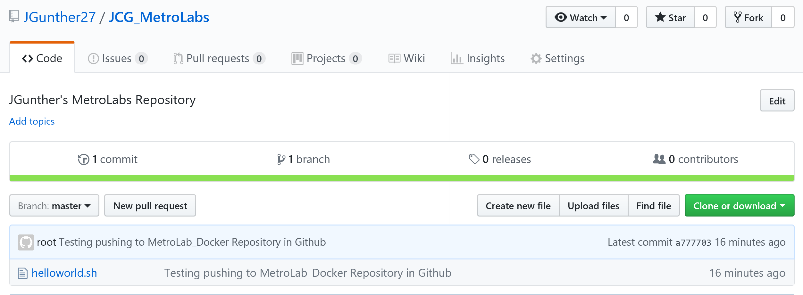
Prepare Local Git Repository to Push to Remote
# git push origin master
Username for 'https://github.com': James.Domino@Dell.com
Password for 'https://James.Domino@Dell.com@github.com':
Counting objects: 3, done.
Writing objects: 100% (3/3), 277 bytes | 0 bytes/s, done.
Total 3 (delta 0), reused 0 (delta 0)
To https://github.com/DemoMetroLab/MetroLab_Docker.git
* [new branch] master -> master
Refresh your github screen to Verify helloworld.sh file in github repository

Slide 31
Installing Puppet

Slide 32
Installing Puppet
Start the VM
Login into VM
Open a Terminal Window

Slide 33
Puppet
$ wget https://apt.puppetlabs.com/puppet5-release-xenial.deb
Download the “puppetlabs-release” package for your OS version.
You can see a full list of these packages on the front page of https://apt.puppetlabs.com/. They are all named puppetlabs-release-<CODE NAME>.deb. (For Ubuntu releases, the code name is the adjective, not the animal.)
Architecture is handled automatically; there is only one package per OS version.
$ sudo dpkg -i puppet5-release-xenial.deb
Install the package by running dpkg -i <PACKAGE NAME>.
$ sudo apt-get update
Run apt-get update to get the new list of available packages.

Slide 34
Installing Puppet
Install Puppet on the Puppet Master Server
On your Puppet master, run:
$ sudo apt-get install puppetserver
Install Puppet on Client Nodes
On your Puppet Client, run:
$ sudo apt-get install puppet

Slide 35
Puppet Post Installation Steps on Puppet Master
In the [main] section of the master’s puppet.conf file, set the dns_alt_names setting to a comma-separated list of each hostname the master should be allowed to use:
$ sudo bash
# cd /etc/puppetlabs/puppet
# echo “dns_alt_names = puppet,puppet.emc.com,PuppetMaster.corp.emc.com,PuppetMaster” >> puppet.conf

Slide 36
Modifying Puppet.conf file to Add Host Names on Puppet Client
$ vi puppet.conf
Edit the puppet.conf file,
Type a to insert the file
Down Arrow to last line of [main]
Type in dns_alt_names = PuppetClient1.corp.emc.com,puppetClient1
Hit escape, then :wq! To save
Should look like this:
[main]
logdir=/var/log/puppet
vardir=/var/lib/puppet
ssldir=/var/lib/puppet/ssl
rundir=/run/puppet
factpath=#vardir/lib/facter
prerun_command=/etc/puppet/etckeeper-commit-pre
postrun_command=/etc/puppet/etckeeper-commit-post
dns_alt_names = PuppetClient1.corp.emc.com,puppetClient1

Slide 37
Adding Hostnames to Host File on both Puppet Master & Client
$ vi /etc/hosts
# Edit the /etc/hosts file to add correct IP’s
127.0.0.1 localhost
#127.0.1.1 PuppetMaster.corp.emc.com PuppetMaster
# The following lines are desirable for IPv6 capable hosts
::1 localhost ip6-localhost ip6-loopback
ff02::1 ip6-allnodes
ff02::2 ip6-allrouters
192.168.56.10 PuppetMaster.corp.emc.com puppet PuppetMaster
192.168.56.20 PuppetClient1.corp.emc.com puppetClient1

Slide 38
Creating CA Certificate – To be Ran on Puppet Master Server
For CA Masters If this is the only puppet master in your deployment, or if it will be acting as the CA server for a multi-master site, you should now run:
# apt install puppet-common
# puppet master --verbose --no-daemonize
This will create the CA certificate and the puppet master certificate, with the appropriate DNS names included.
Once it says Notice: Starting Puppet master version <VERSION>, type ctrl-C to kill the process.

Slide 39
Installing Jenkins

Slide 40
Installing Jenkins Server on Puppet Master Server
Installing Jenkins
# wget -q -O - https://pkg.jenkins.io/debian/jenkins-ci.org.key | sudo apt-key add -
# sudo sh -c 'echo deb http://pkg.jenkins.io/debian-stable binary/ > /etc/apt/sources.list.d/jenkins.list'
# sudo apt-get update
# sudo apt-get install jenkins

Slide 41
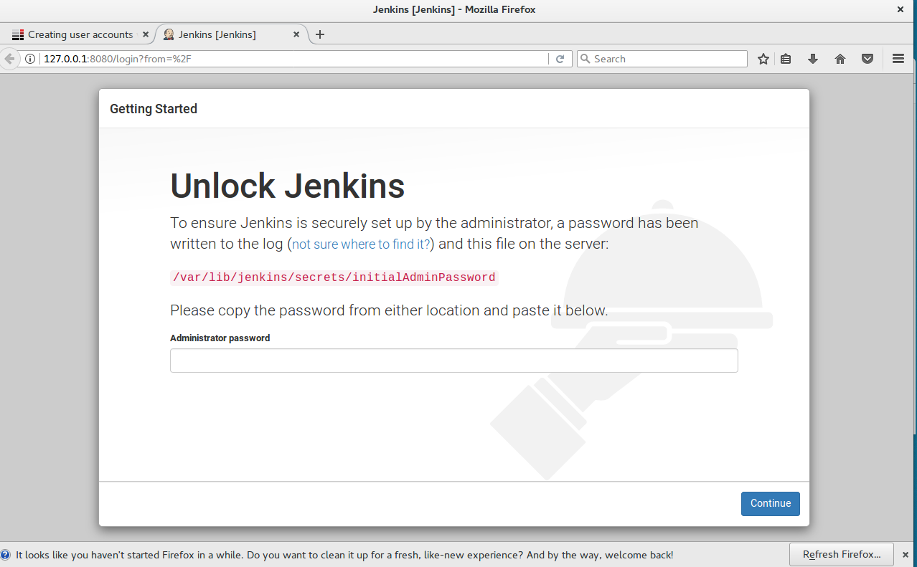
First Login to Jenkins
Launch Firefox, browse to: http://127.0.0.1:8080
From Terminal window, cat /var/lib/Jenkins/secrets/initialAdminPassword
Highlight and copy password
Paste into Firefox window

Slide 42
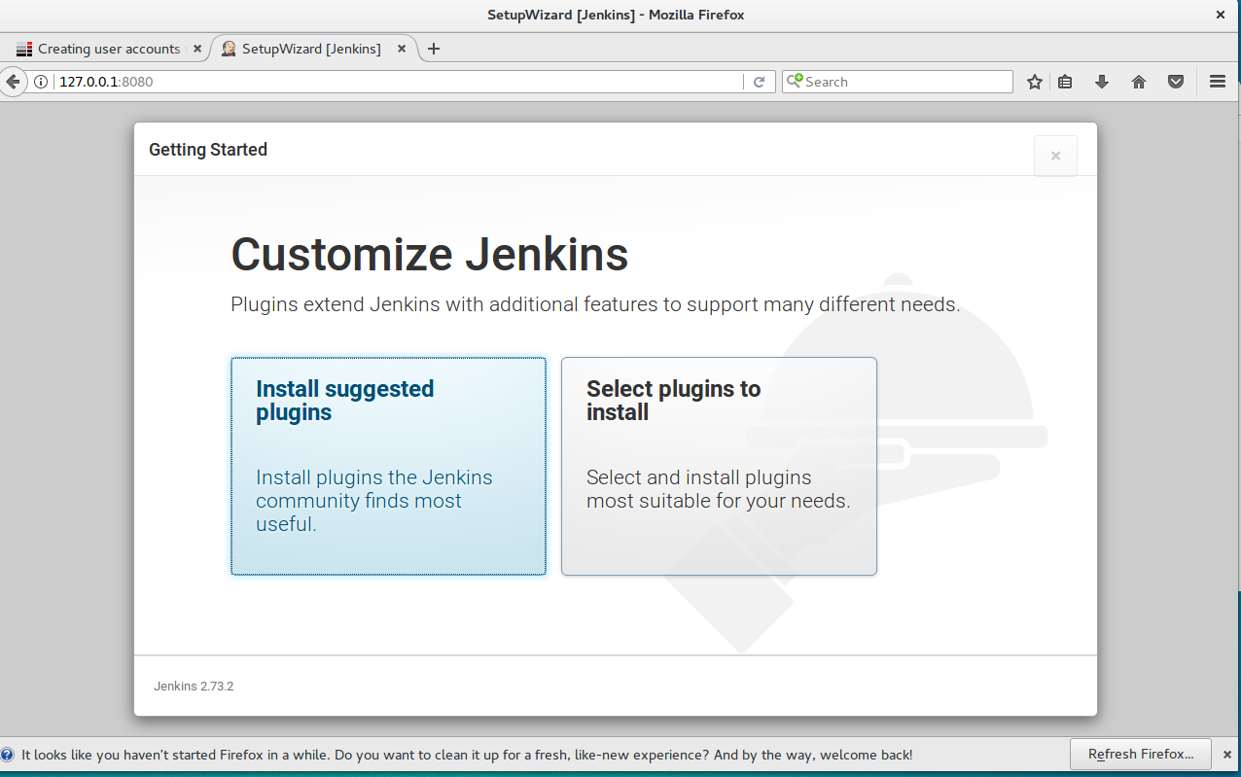
Jenkins Plugins
Click install suggested Plugins

Slide 43
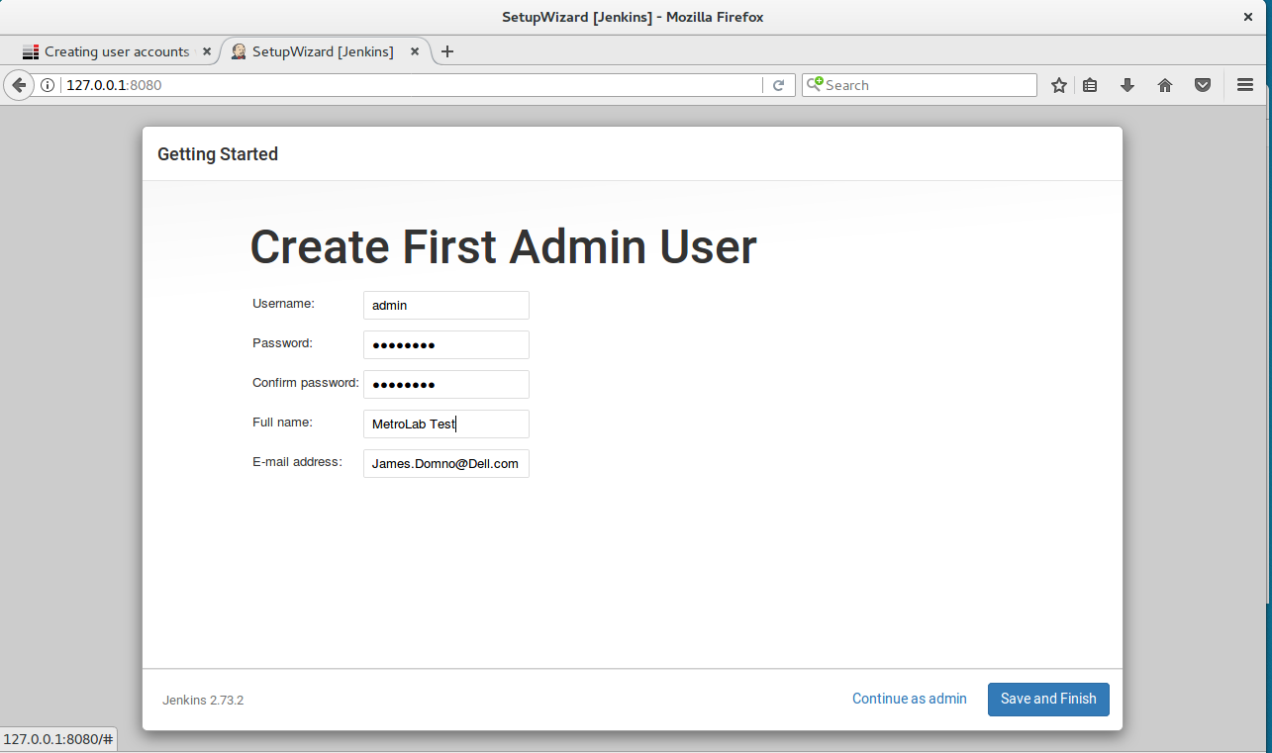
Create First Admin User & Password
ID: admin
PWD: M3tr0Lab

Slide 44
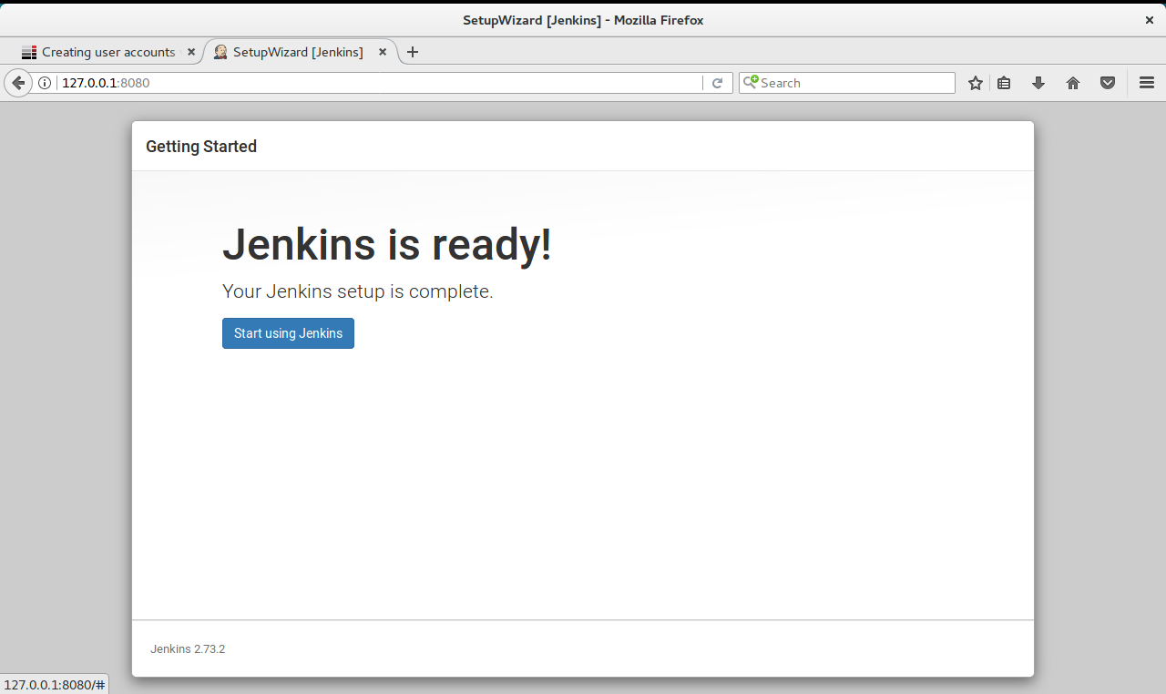
Jenkins Installed
Click Start using Jenkins

Slide 45
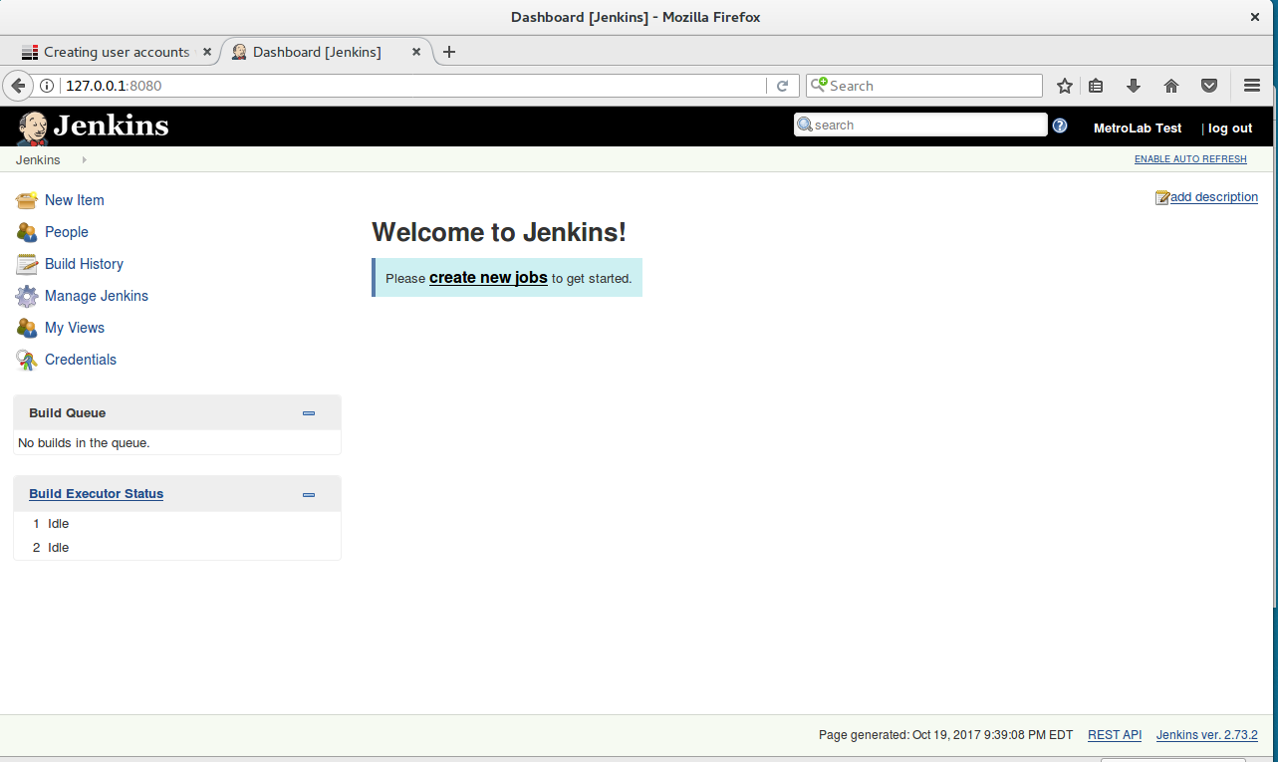

Slide 46
Session Summary
Configured Network for VMs
Created a Github account and tested access from VM
Installed Puppet
Master
Client
Installed Jenkins

Slide 47
Questions?

Slide 48
Thank You

